Slide 1


Automation Using Protractor
Prepared By –Shrish Tripathi

Slide 2
Introduction to Protractor
Selenium is software testing framework web application which automates browsers.
Having support for almost all major browsers
Whatever you do in the browser while testing your application can be automated using selenium.
Selenium Remote Control (RC) is a server, written in Java, that accepts commands for the browser via HTTP.
RC makes it possible to write automated tests for a web application in any programming language, which allows for better integration of selenium in existing unit test frameworks.

Slide 3
Introduction to Protractor
Successor to selenium RC.
Unlike in Selenium 1, where the selenium server was necessary to run tests, selenium WebDriver does not need a special server to execute tests,. Instead, the WebDriver directly starts a browser instance and controls it.
WebDriver basically refers to the client libraries(language bindings) and the implementation of the individual browser controlling code.
WebDriver introduces a JSON WIRE PROTOCOL for various language bindings to communicate with the browser controller.
So at one end there is the language binding and a server selenium server. Both communicate using the JSON wire protocol.

Slide 4
Introduction to Protractor WebDriver JS
WebDriver has a number of bindings for various languages like Ruby, Python etc. JavaScript being the language of choice for the web, is the latest one to make it to the list.
WebDriver JS is simply a wrapper over the JSON wire protocol exposing high level functions to make our life easy.
It has two different bindings selenium driver & WebDriver JS based on node module.
WebDriver JS has an important difference from other bindings in any other language – it is asynchronous.

Slide 5
Introduction to Protractor Node JS
Node.JS is a server side platform built on google chrome’s javascript engine(V8 Engine)
Asynchronous and Event Driven: The server moves to the next API after calling it and a notification mechanism of Events of Node.JS helps the server to get a response from the previous API Call.
Very Fast
Single threaded but higly scalable: Node.JS uses a single threaded model with event looping. Event mechanism helps the server to respond in a non-blocking way.
No Buffering

Slide 6
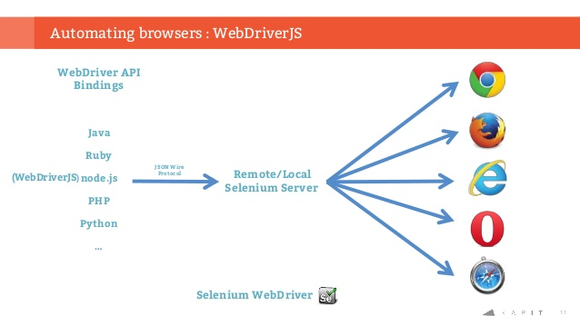
Introduction to Protractor

Slide 7
Introduction to Protractor Jasmine
Jasmine is a behavior – driven development BDD framework for testing JavaScript code.

Slide 8
HIGH LEVEL AGENDA
What is Protractor
What is the need of it
Difference between normal application and AngularJS Application
What is SPA Application

Slide 9
Prerequisites
Selenium
JavaScript
Even if you are not familiar with above then also you can learn protractor easily.

Slide 10
What is Protractor
Protractor is a library by the Angular team which is a wrapper on WebDriver JS and Jasmine.
Protractor is end to end test framework for AngularJS applications.
Protractor runs tests against your application running in a real browser.
Protractor is built on top of web driver JS protocol, which uses native events and browser specific drivers to interact with your application
Protractor supports Angular specific locators which will useful to test angular specific elements.
You no longer need to add await and sleep to you test.

Slide 11
Why we need protractor ? when we have selenium
Sometimes its very difficult to handle web elements in AngularJS application using selenium or other tools.
Protractor is NodeJS program which is written in JavaScript and runs with Node to identify the web elements in AngularJS application.
It can be used to test non AngularJS application as well. But preferable is Selenium it has its own advantages.

Slide 12
Introduction to Protractor Features that makes Protractor a Powerful library:
Allows access to all Selenium WebDriver methods with additional locator strategies
Allows running tests targeting remote addresses
Can take advantage of selenium grid to run multiple browsers at once
Integrated with powerful tools such as NodeJS, Selenium, webDriver, Jasmine, Cucumber and Mocha.
Less Sync Issues – Protractor also speeds up your testing as it avoids the need for a lot of “Sleeps” and “waits” in your tests, as it optimizes sleep and wait times.
Protractor allows tests to be organized based on Jasmine, thus allowing you to write both unit and functional tests on Jasmine.
It runs on real browsers and headless browsers.

Slide 13
Deep-diving into Protractor
The first version of Protractor was released in July, 2013, when the framework was basically a prototype of a testing framework. However, Google, with the support of the testing community, is evolving the framework to follow the evolution of AngularJS and to meet the needs of the community that is using AngularJS.
The Protractor project is public in Github and you can follow the issues in the project

Slide 14
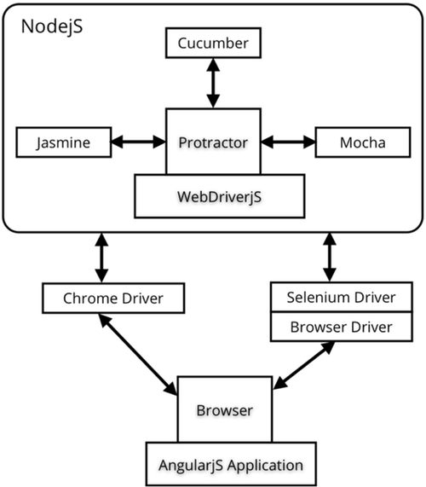
Deep-diving into Protractor

Slide 15
SetUp

Slide 16
Install Node.Js
Open the link https://nodejs.org/en/download/
Select the file and download
Install the file in your machine

Slide 17
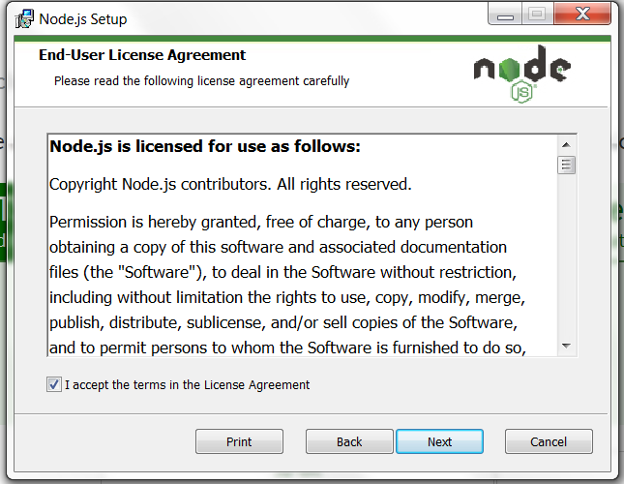
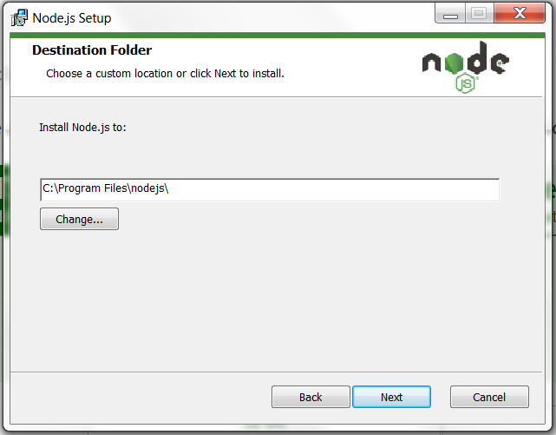
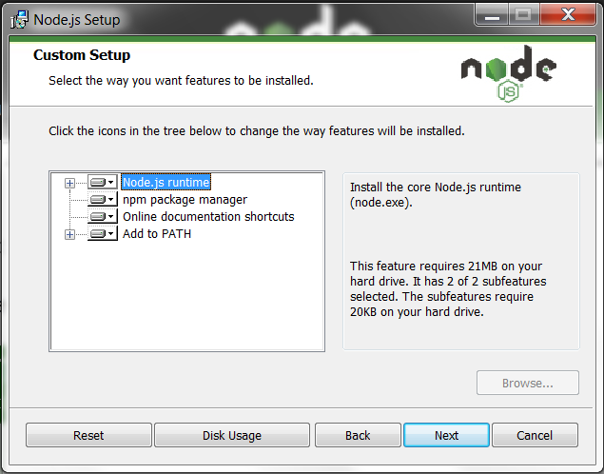
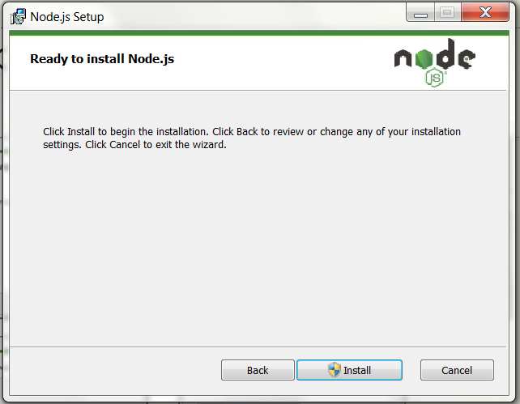
Install Node.Js

Slide 18
Install Visual Studio Code
Search visual studio code in google
Open the link https://code/visualstudio.com/download
Select the file and download
Install the file

Slide 19
Install Protractor
Globally - Open Command and type - npm install -g protractor
Locally - npm install protractor
Install WebDriver manager using the command
webdriver-manager update
webdriver-manager start
Once the above installation done check the URL - http://localhost:4444/wd/hub
If the connection is established then the protractor is running in your machine.

Slide 20
Quick Look on Selenium

Slide 21
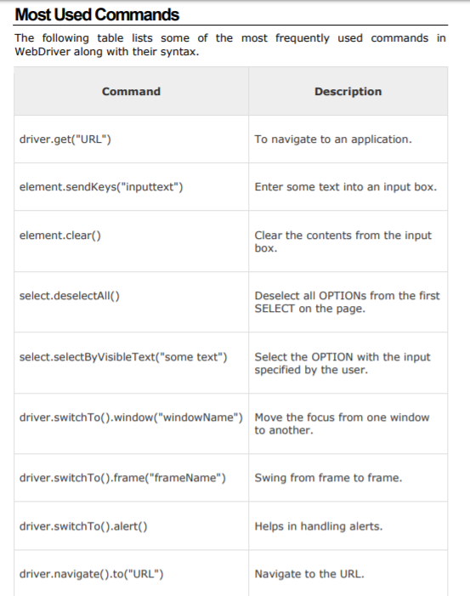

Slide 22
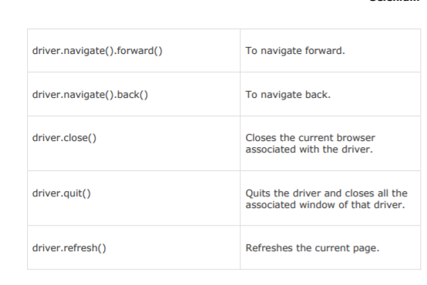

Slide 23
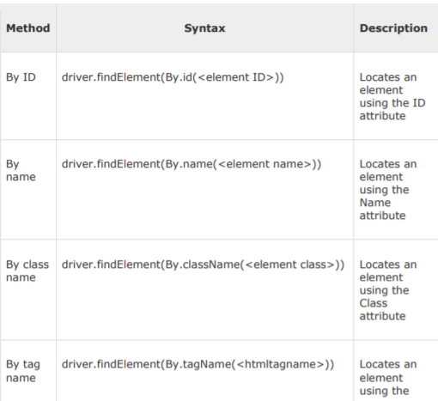
Selenium Locators

Slide 24
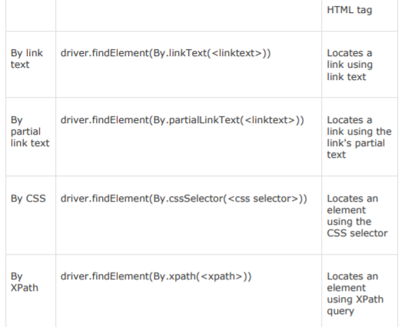

Slide 25






Slide 26
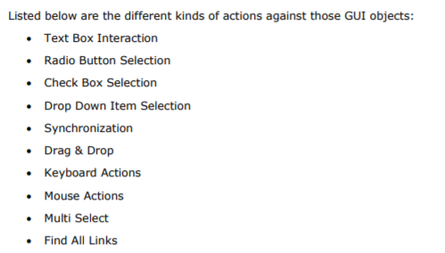

Slide 27
Webdriver:
Webdriver:
Close()
Quit()
Findelement(By)
Findelements(By)
Getwindowhandle()
Gettitle()
Navigate()
Switchto()
Lot more…….

Slide 28
Webelement:
Webelement:
Click()
Findelement(by)
Findelements(by)
Isenable()
Isselected()
Gettext()
Submit()
Sendkeys()
Getcssvalue()
Lot more….

Slide 29
Getting Started

Slide 30
Understanding the Config File
Protractor needs 2 files to run, a spec file and configuration file.
Configuration file : This file helps protractor to where the test files are placed(specs.js) and to talk with selenium server(selenium address). Chrome is the default browser for protractor.
Spec file ; This file contains the logic and locators to interact with the application

Slide 31
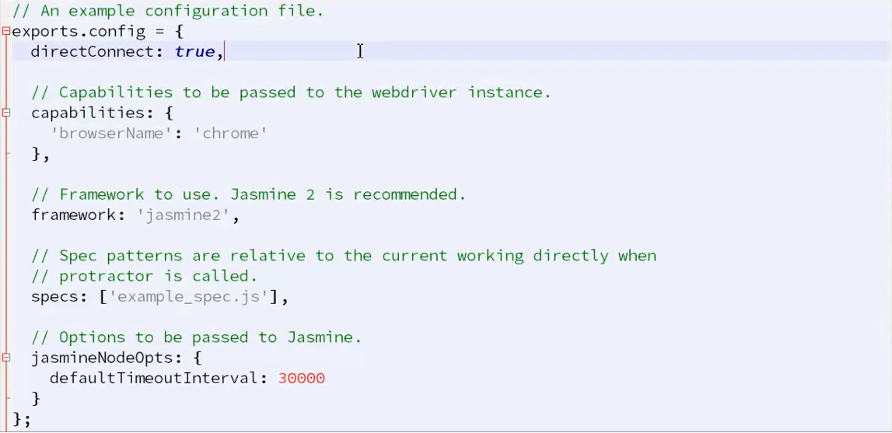
Understanding Config file

Slide 32
Sample Spec file
describe('Test entering into an input box', function() {
it('executing input box test', function() {
browser.get('https://angularjs.org');
element(by.model('yourName')).sendKeys('Sanjay');
element(by.binding('yourName')).getText().then(function(text){
console.log(text);
});
});
});

Slide 33
Running sample Test
Update the WebDriver manager
Start the WebDriver Manager
Run the Protractor conf.js in command

Slide 34
Jasmine Framework
Jasmine is a behavior – driven development framework for testing JavaScript code.
By Following BDD procedure, Jasmine provides a small syntax to test the smallest unit of the entire application instead of testing it as a whole.
Jasmine is default framework for protractor
Open source
No External dependency
Easy to use, clean code
We will deep dive more on Jasmine in upcoming session

Slide 35
Jasmine Framework
Describe("This is a section", function(){
It("test case 1", function(){
});
It("Test Case 2", function(){
});
It("Test case 3", function(){
});
});

Slide 36
Agenda
Basic Approach- Setup light weight framework
Intermediate Approach – Protractor+ Jasmine Framework
Advance Part 1- Protractor + Data provider + Jasmine
Advance Part 2- Deep dive on End to End Framework

Slide 37
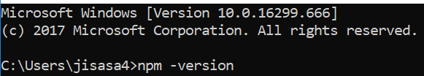

Slide 38
Clean your Visual Studio Code

Slide 39
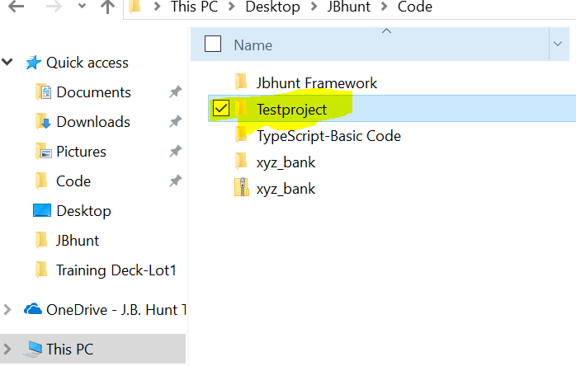
Go to your drive and create blank folder or Workspace

Slide 40
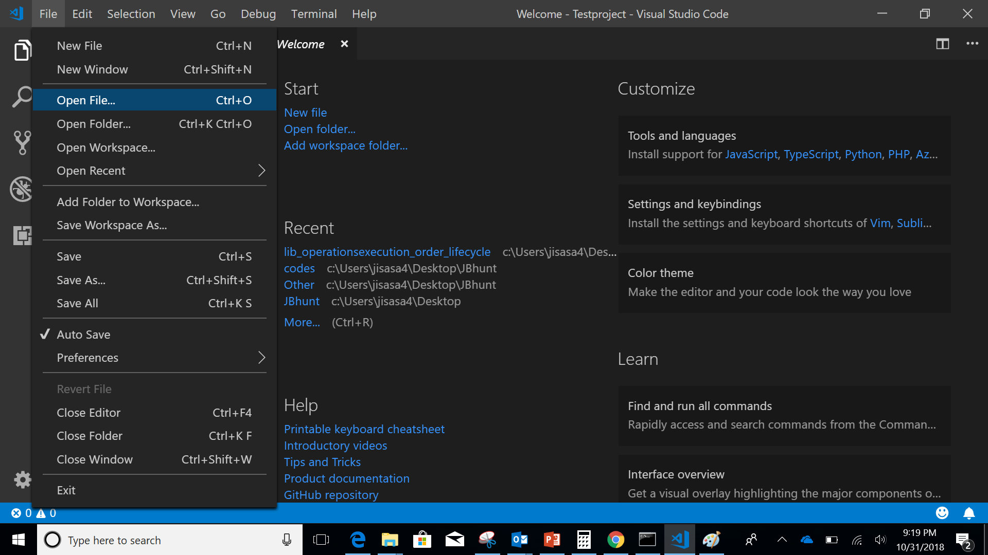

Slide 41
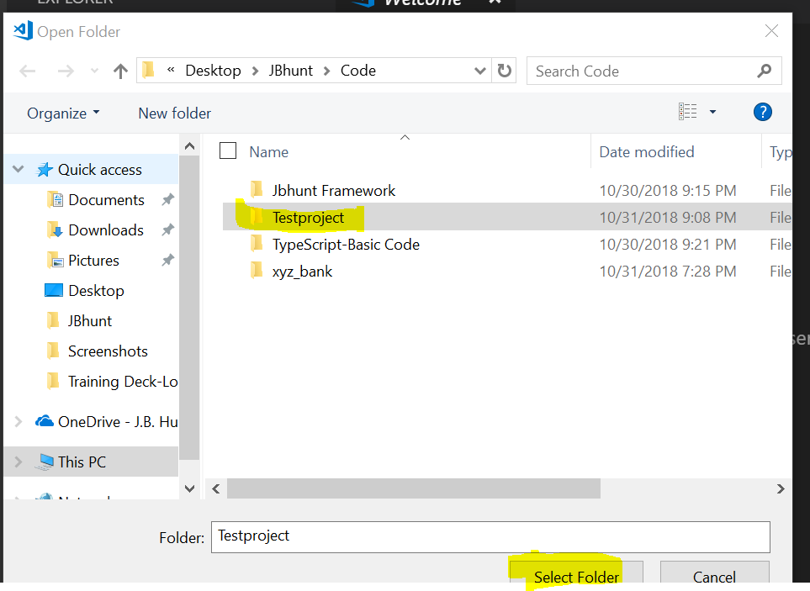

Slide 42
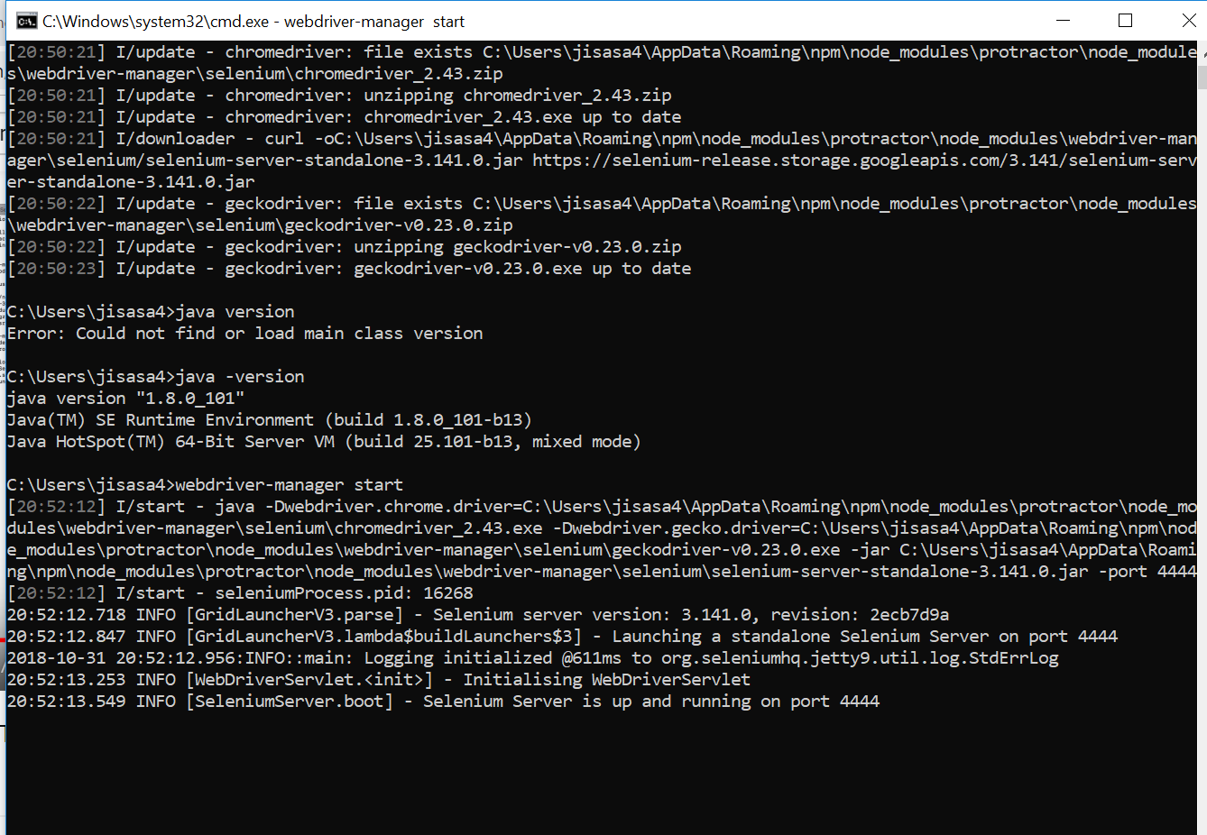
Don’t close your previous terminal
Other wise, your Selenium server will close

Slide 43
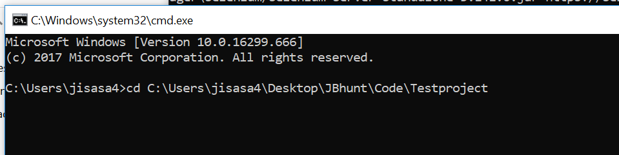
Open another terminal and go to your project folder

Slide 44

Type npm init

Slide 45
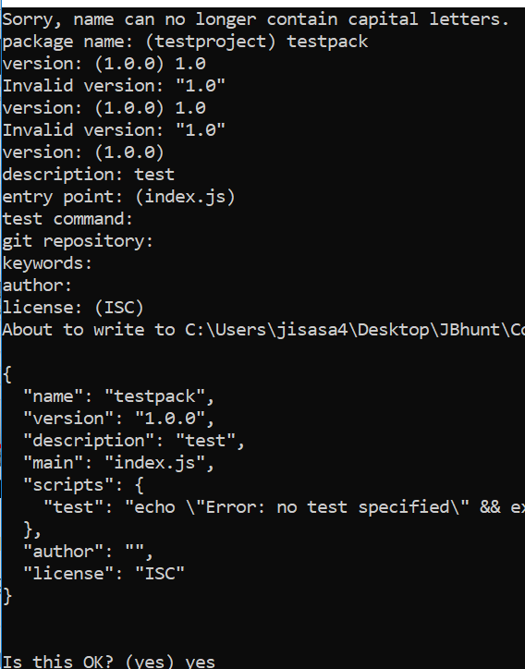

Slide 46
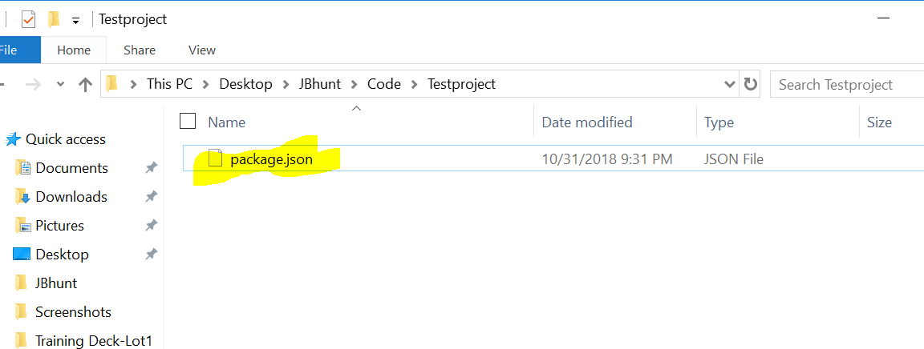
Package.json created under your project folder

Slide 47
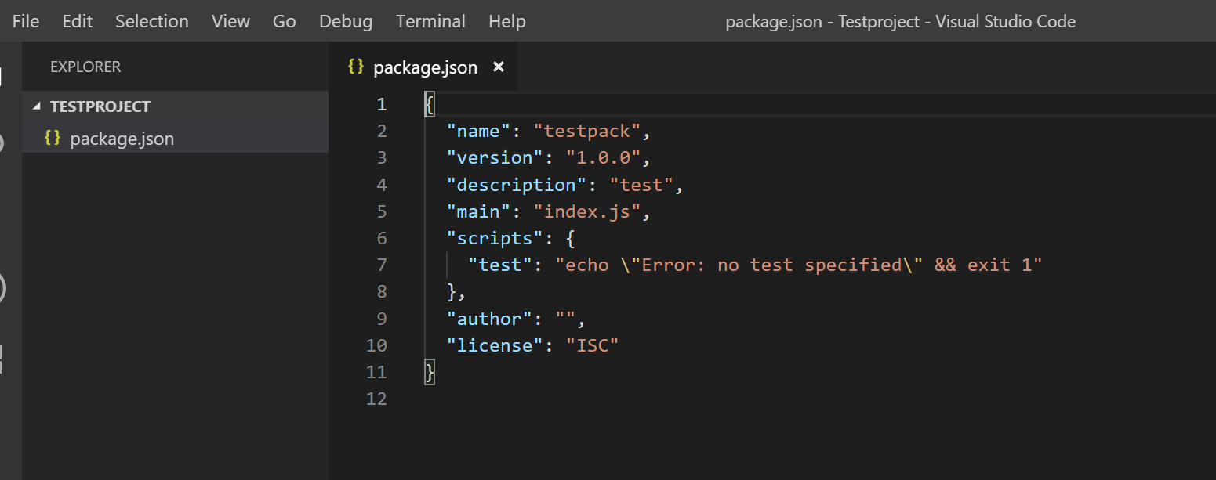
Open visual studio-you can see package.json created

Slide 48
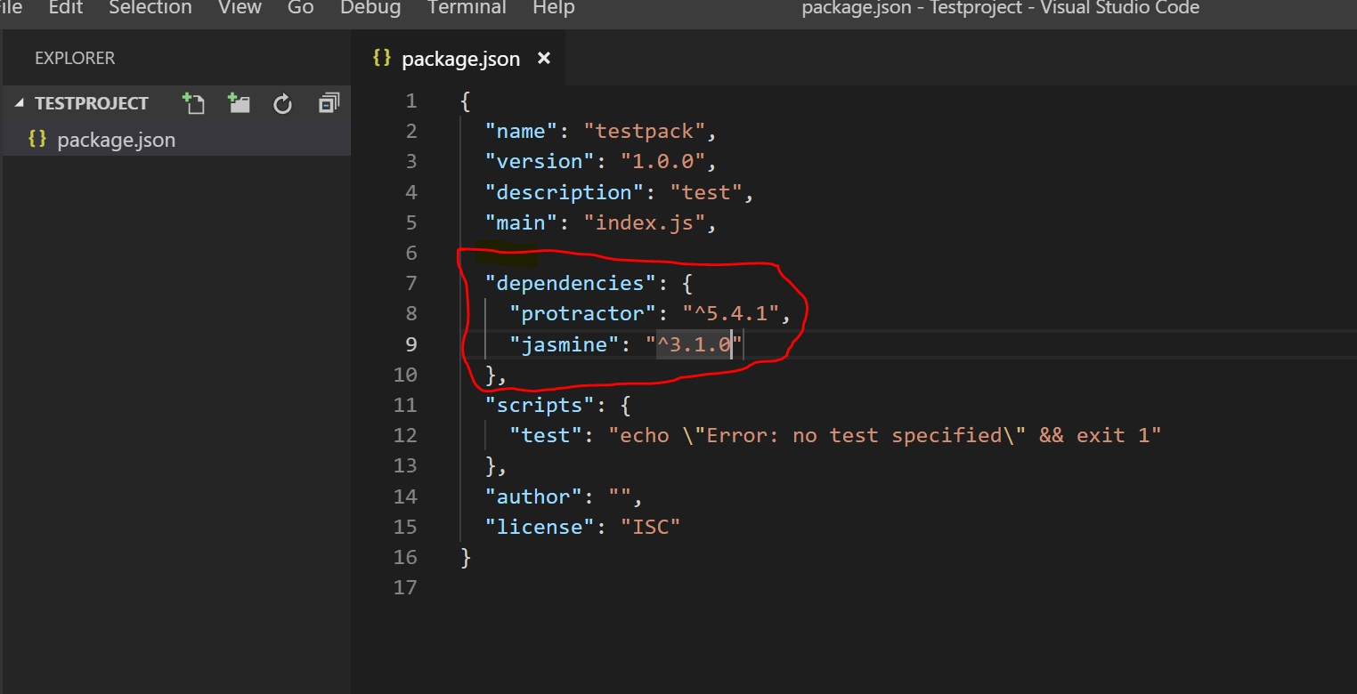
Add dependencies in Package.JSON and click on Save

Slide 49
Open Visual studio terminal and type ..

Slide 50
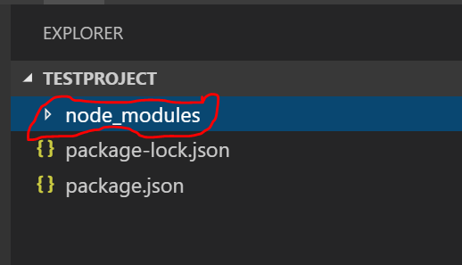
..node_modules added

Slide 51
Add conf.ts file
This File helps protractor to where the test files are placed (specs.js) and to talk with Selenium server (Selenium Address). Chrome is the default browser for Protractor.

Slide 52
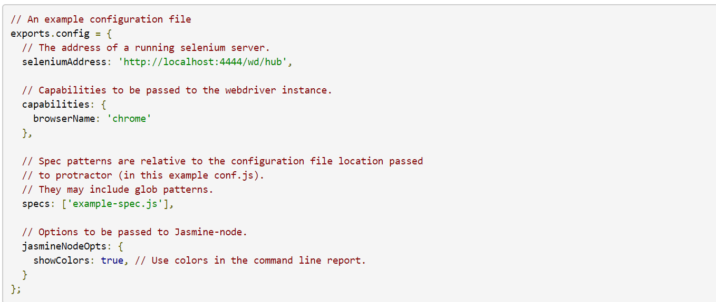

Slide 53
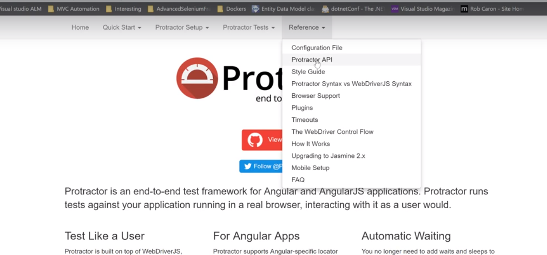

Slide 54
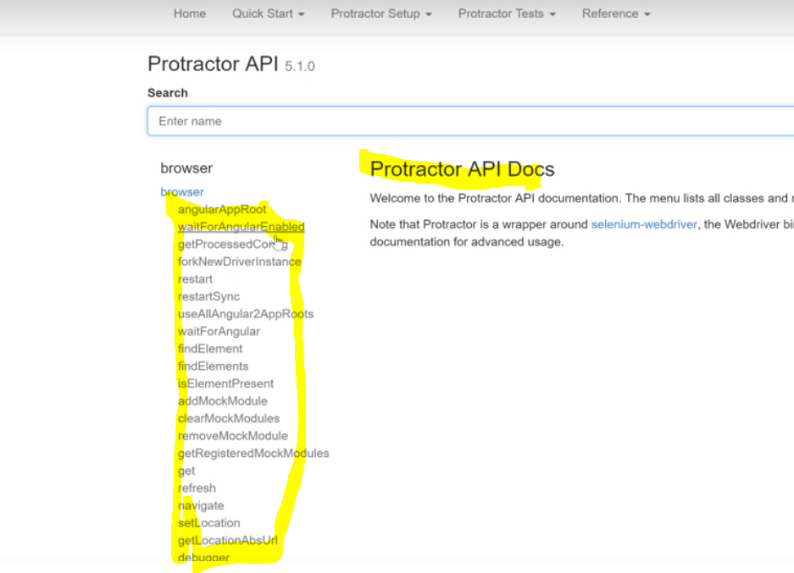

Slide 55
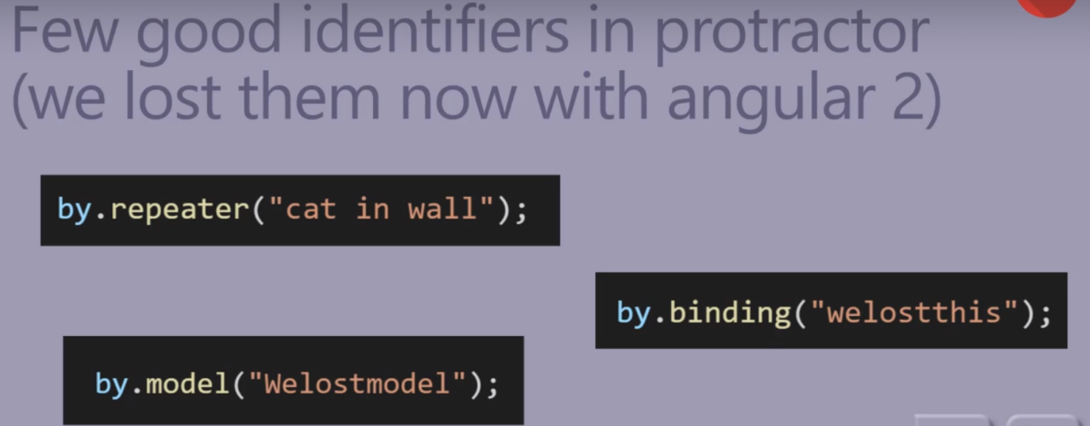

Slide 56
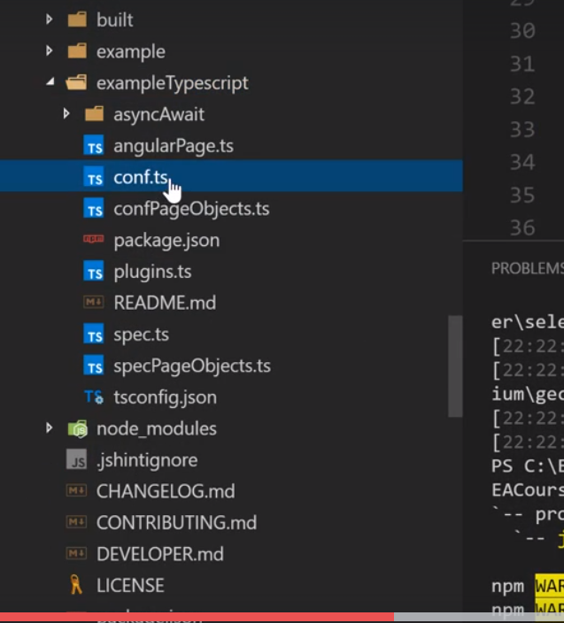
Good for Beginners

Slide 57


Slide 58


Slide 59
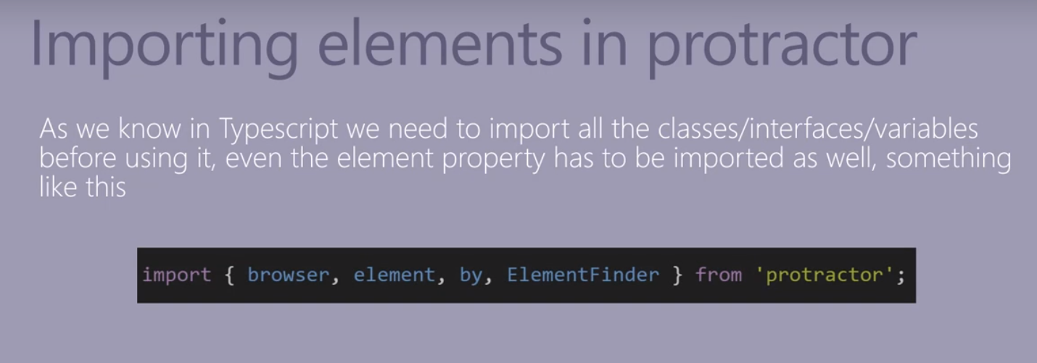

Slide 60
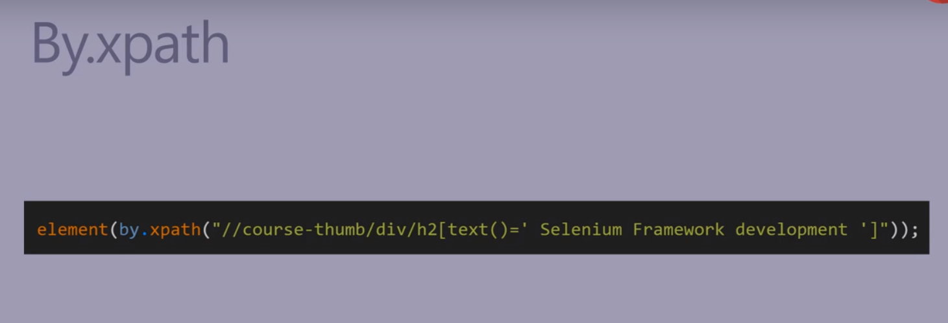

Slide 61
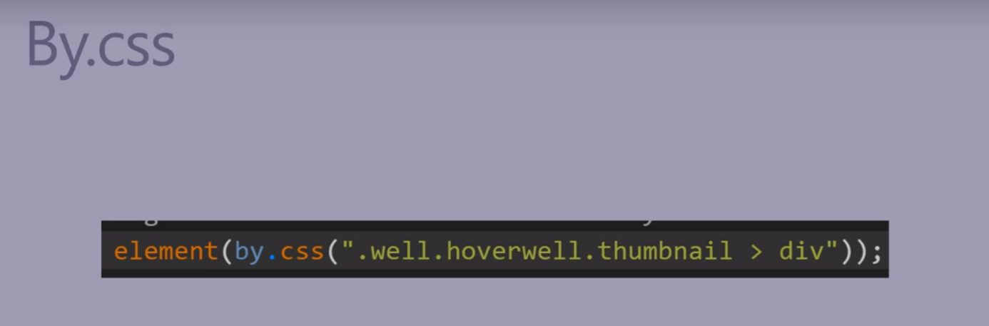

Slide 62
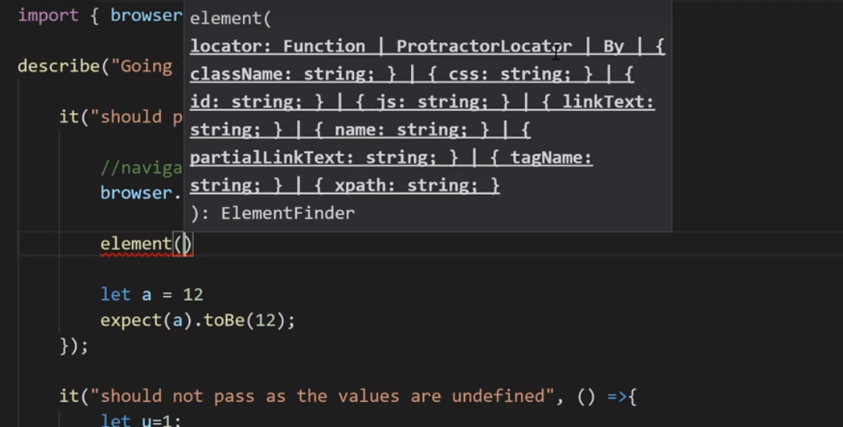

Slide 63
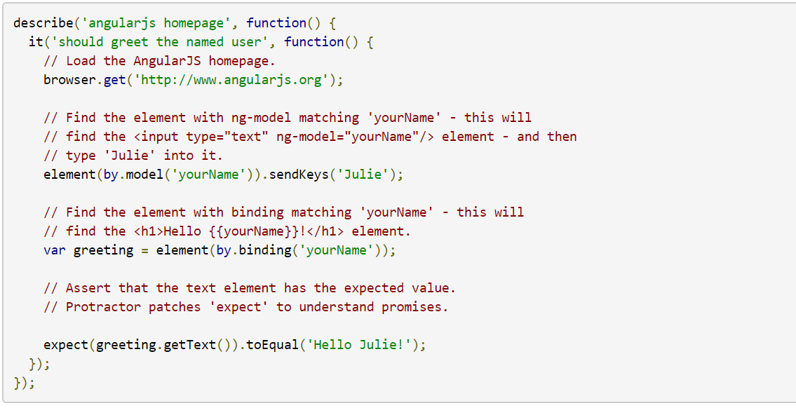
Add spec.ts file
This File contains the logic and locators to interact with the application.

Slide 64
Open the folder (XYZ_Bank) in Visual Studio

Slide 65
Let’s Develop libraries

Slide 66
